Slide 1
DEFINE (WP4&WP5) scenario building & emission calculations
June, 14th/15th 2012, @IHS
Sigrid Stix, Friedrich Pötscher, EAA
© maodesign

Slide 2
Environment Agency Austria (EAA)
The EAA is a major player in environmental consulting, setting standards and developing methods for the sustainable development of society.
founded in 1985, by Environmental Control Act
since, 1999 limited liability company
office is located in vienna
staff 470, (FTE 395),
of whom 68% are university graduates, 50% women
annual turnover: approx. 40 million Euro
(national projects: approx. 32 million Euro)
(international projects: approx. 8 million Euro)
Notes:
as such it is 100% owned by the Republic of Austria, which is represented by the Ministry of Agriculture, Forestry, Environment and Water Management (“Life Ministry”).
Turnover in 2011 – approx. 39,6 million EUR
National projects – approx. 32 million EUR
International projects – approx. 7,6 million EUR
uses an interdisciplinary approach to develop perspectives for our national and international customers and clients for the sustainable development of society.

Slide 3
References (Departement transport & noise)
ELMAR together with IHS:
market potential for new car registrations in vienna and its surroundings (EV, PHEV, HEV, E85, CNG, CV) and environmental effects (ghg-emissions direct and upstream)
LCA-PLUS
Life Cycle Assessment for different powertrain options. (HEV, PHEV, CV, E85, CNG, fuell cell and hydrogen from renweable electrolysis).
APSTAP
Alternative Propulsion System Technology Application: development of an upstream emission calculator for the (A3PS) platform.
Scenarios for Electromobility in Austria (2010)
various scenarios for the indtroduction of electromobility & environmental effects on behalf of Verbund.

Slide 4
The EEA-Model for scenario building in the Austrian transport sector
EEA-Model from Umweltbundesamt is based on the global results from GLOBEMI Model (Transport Volume Model by TU-Graz), which is used for calculating Austrian Emission Inventory. Historic data and projections are used for modeling specific periods.
Main difference/adaption for DEFINE Project:
GLOBEMI: Emission Class and Capacity based approach
EEA Model: Vehicle Segment based approach, taking into consideration available alternative powertrain options per vehicle segment. Segment specific market is defined via reference vehicles and alternative powertrain options.
The segment-and vehicle-specific view allows for greater accuracy in terms of emissions and energy balances allocated at annual new vehicle registrations at segment specific level.

Slide 5
Baseline: Road Transport Model GLOBEMI (Input for EEA-Model)
Modul 1: Vehicle stock
Vehicle survival
probatillity
Modul 2:
Transport
volume
Calibration
Module 3:
influence parameters
Modul 5:
Fuel sold
Emission- factors
developed at the Technical University of Graz
Institute for Internal Combustion Engines and Thermodynamics (ICE & THD)
Univ.-Prof. DI. Dr. Stefan Hausberger
Modul 4:
Fuel consumption & emissionen

Slide 6
GLOBEMI – Output (Input for EEA-Model)
Outputs of GLOBEMI (per annum):
Specific transport volume per vehicle/class
Total transport volume
Total traffic volume (pkm, tkm)
Specific fuel consumption (engine type, pkm, tkm, size,..)
Total fuel consumption
Specific emissions (engine type, pkm, tkm, size,..), HC, CO, NOx, PM, CO2, SO2
Total Emissions
Evaporation Emissions
…

Slide 7
Additional Input Data for EEA-Model
Vehicle segment specific registrations (Statistics Austria)
Vehicle segment specific mileage (Eurotax)
Vehicle segment specific purchase (market research), maintainance costs (Eurotax), depreciation (Eurotax)
Vehicle segment and powertrain specific
Emission factors (HBEFA, own calculations)
Energy consumption factors (HBEFA, own calculations)

Slide 8
Definition of Reference Vehicles
For each vehicle segment, a reference vehicle is defined which is used as a basis for comparative analysis on an annual scale.
Vehicle Class Specific Reference vehicles are based on annual sales figures. Vehicle segments are defined as established by the European Commission
Additionally, following vehicle attributes are taken into consideration:
Typical engine
Typical equipment

Slide 9
Definition of Reference Vehicles – Example (2)
Neuzulassungen | 01-2009 bis 12-2009 | Anteil in %
GESAMT | 319.403 | 100,0
Nach Segmenten
-B- Kleinwagen | 81.341 | 25,5
-C- Mittelklasse | 73.293 | 23,0
-D- Obere Mittelklasse | 40.050 | 12,5
-SUV- SUV und Geländewagen | 33.238 | 10,4
-MD- Van/Family Van | 31.772 | 10,0
-A- Kleinstwagen | 24.878 | 7,8
-M- Mehrzweckfahrzeuge/Vans | 11.033 | 3,5
-E- Oberklasse | 6.983 | 2,2
Marken/ Typen | Personenkraftwagen |  |  | Segment |  |  | Meistgewählte Motorisierung
 |  | Jän. - Dezember 2009 | Anteil in %
VW | Golf | 21.022 | 6,6 | Referenz Segment C |  |  | GOLF VI 1,6TDI
VW | Polo | 8.928 | 2,8 | Referenz Segment B |  |  | POLO 1,2
Seat | Ibiza | 8.018 | 2,5
Skoda | Octavia | 7.307 | 2,3 | Referenz Segment D |  |  | OCTAVIA 1Z 1,9TD KOMBI
Skoda | Fabia | 7.213 | 2,3
Audi | A4 | 6.988 | 2,2

Slide 10
Definition of vehicles with alternative Powertrains
Imaging of the real (future) market situation on the basis of
manufacturer announcements
model cycles
own research
Definition of alternative fuel vehicles on the basis
same vehicle segment and/or direct competition with the reference vehicle
The following attributes should be as clos as possible to the reference vehicle /equivalent.
equipment
performance
sale prices

Slide 11
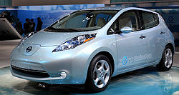
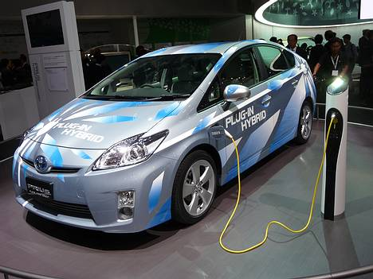
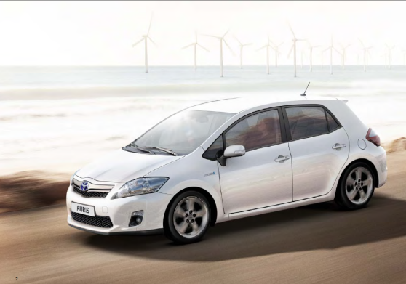
Definition of vehicles with alternative Powertrains (2) – Example Segment C
Reference Vehicle VW Golf 1.6TDI
4 Alternatives
EV: Nissan Leaf
PHEV: Toyota Prius Plug-In
HEV: Toyota Auris Hybrid
E85: Ford Focus

Slide 12
EEA-Model Calculations and Outcome (1)
Calculation of Emissions/Energy Consumtion and Savings according to input on purchase decisions from customers.
Vehicle segment specific
Powertrain specific
Annually or cumulated over certain time period
Tank-to-Wheel
Well-to-Wheel

Slide 13
emission calculations (WP5) (1)
The average choice probabilities of ech alternative over all individuals for new car registrations can be interpreted as market shares (Output from WP3=Input WP5).
weighting of sample market shares per segment with new car registrations per segment (Eurotax) (=new market development)
optional: regional weighting, if sample characteristics differ from Austria.

Slide 14
emission calculations (WP5) (2)
direct emissions are based on HBEFA 3.1, adaptaded by EAA using own calculations.
HBEFA (www.hbefa.net)
developed on behalf of the Environmental Protection Agencies of Germany, Switzerland and Austria. Today it is supported by(Sweden, Norway, France) as well as the JRC (European Research Center of the European Commission).
provides emission factors, i.e. the specific emission in g/km for all current vehicle categories (PC, LDV, HDV, buses and motor cycles), each divided into different categories, for a wide variety of traffic situations.
Notes:
Es wird in Kooperation mit Deutschland, der Schweiz und den Niederlanden entwickelt und stellt das genaueste Verkehrsemissionsmodell in Europa dar. Die Entwicklung des Handbuchs wird in Kooperation von BMVIT, BMLFUW und Umweltbundesamt erstellt, das Umweltbundesamt ist die zuständige Stelle für die nationale Koordination der Arbeiten.
Grundlage für die Modellentwicklung stellt die Messung von Emissionen an Fahrzeugen am Rollenprüfstand bzw. Motorprüfstand dar. Die ermittelten Emissionen werden in Emissionsfaktoren für reale Fahrsituationen umgelegt, um eine realitätsnahe Abbildung des Schadstoffausstoßes zu erhalten. Das Handbuch liefert die Emissionsfaktoren für ca. 50 unterschiedliche Verkehrssituationen. Darüber hinaus können Durchschnittswerte für innerorts, außerorts und Autobahn sowie ein globaler Durchschnittswert berechnet werden. Über die Eingabemaske können Fahrzeugkategorie, die zu berechnenden Schadstoffe bzw. der Kraftstoffverbrauch, die Verkehrssituation und das Bezugsjahr ausgewählt werden. Das Handbuch enthält Daten über die österreichische Flottenzusammensetzung sowie spezifischer Fahrleistungen nach Fahrzeugart und Abgasklasse.
Für eine detaillierte Beschreibung der Methodik siehe INFRAS, (2004).
The Handbook of Emission Factors for Road Transport (HBEFA) was originally developed on behalf of the Environmental Protection Agencies of Germany, Switzerland and Austria. In the meantime, further countries (Sweden, Norway, France) as well as the JRC (European Research Center of the European Commission) are supporting HBEFA.
HBEFA provides emission factors, i.e. the specific emission in g/km for all current vehicle categories (PC, LDV, HDV, buses and motor cycles), each divided into different categories, for a wide variety of traffic situations.

Slide 15
emission calculations (WP5) (3)
upstream emissions are calculated taking a Life-Cycle perspective using GEMIS 4.7
GEMIS was developed by Öko-Institut, EAA is responsible for Austrian update.
With GEMIS primary energy consumption, pollutant emissions and material flows can be compared for all stages of energy production, conversion and utilisation.
attributional LCA (ALCA) vs contributional LCA (CLCA)
ALCA – business as usual (average attributes)
CLCA – aims to predict consequences of changes (indirect effects) (no standards exist – high uncertainties )
Notes:
GEMIS is a computer instrument for environmental impact and cost analysis of energy, transport and materials systems. Primary energy consumption, pollutant emissions and material flows of energy and transportation systems can be compared, and consumption and emissions can be calculated for all stages of energy production, conversion and utilisation. The current version 4.0 contains new data on new technologies, and the computer model was updated so that the data and scenarios can be used also in programs outside GEMIS. Data from other sources were included in the database as well. ;
Consequentional
ALCA is a “business-as-usual” scenario analyzing current practices, and does not include indirect effects such as indirect land use change. CLCA analyzes potential changes in a system, and can include indirect effects.
“Attributional” LCA (ALCA) is also known as the ‘businessas-
usual” scenario. Most LCA studies fall into this category.
The life cycle impact is quantifi ed by accounting
for environmentally relevant physical fl ows to and
from a product system. It is “business as usual”
because the values used are averages based on
normal, current business practices.
Attributional LCA aims to describe the average attributes
of the current, prevalent method of doing something.
Attributional LCA can answer a range of questions, such as:
how much energy is currently used to produce soy biodiesel,
Consequential” LCA (CLCA), in contrast, aims to predict the
consequences if changes are made to an established process.
For example, a CLCA could be used to answer the question,
how much CO2 would be released into the atmosphere if the
production of soy biodiesel doubled?

Slide 16
phases in a life cycle assessment

Slide 17
system boundaries

Slide 18
emission calculations discussion(4)
currently outside the system boundaries:
disposal and recycling of the vehicles
aftermarket use of vehicles
disposal and recycling of battery systems
(disposal and recycling of photovoltaic-moduls)

Slide 19
selected results

Slide 21
CO2-Savings (W2T)
Notes:
2010 pkw 9,7 Mio T CO2/year (savings are 2,3%/Jear) AEI 2011

Slide 22
Discussions
technology development
segment approach for scenario building
LCA-approach: system boundaries
attributional vs. consequentional approach?
GEMIS database
coordination between partners (WP5&6) on all phases of LCA (slide 17)

