Slide 1
DIW electricity market model for the project DEFINE-Electromobility+
Kick-off Meeting at IHS Vienna
Andreas Schröder
Vienna, 14 June 2012

Slide 2
Part 1 – DIW Modeling Background

Slide 3
Deutsches Institut für Wirtschaftsforschung
DIW Berlin founded in 1925
180 Employees (100 research staff)
Known for macro analysis but strong in energy market analysis
Department Energy/Transport/Environment

Slide 4
Our models
Equilibrium models with oligopolistic structures (MCP)
Technical power plant dispatch models (MILP/LP)
Power plant investment model
Power plant dispatch model
Combined investment-dispatch model
Strategic storage -dispatch model
Unit commitment model
DC load flow models (LP/QCP)
Grid model with storage and dispatch

Slide 5
DIW experience
Projects
StorRES – Integration of Renewable Energies into the German Power System. Unit commitment model (MILP).
Funded by Federal Ministry for the Environment 2011-2013
MASMIE – Analytic models for the Energy Transformation. Mostly MCP models for electricity dispatch, including stochasticity.
Funded by the Mercator Foundation 2012-2014
ImpRES – Effects of Integration of Renewable Energies. Project with Fraunhofer ISI, GWS, IZES.
Funded by the Ministry for the Environment 2011-2015
Publications
Traber, Kemfert (2011). Gone with the Wind? Electricity Market Prices and Incentives to Invest in Thermal Power Plants under Increasing Wind Energy Supply, Energy Economics
Schill (2011). Electric Vehicles in Imperfect Electricity Markets: The Case of Germany, Energy Policy
Schill (2011). Electric Vehicles. Charging into the Future, DIW Weekly Report
Schröder, Traber (2012). The Economics of Fast Charging Infrastructure for Electric Vehicles, Energy Policy

Slide 6
Part 2 – DIW Model for DEFINE

Slide 7
Motivation and objectives
Research question
Effect of EV charging on power plant unit commitment
Power sector CO2 emissions
Is V2G in reserve markets a viable business model?
Model
Unit Commitment Model as MILP in GAMS
Includes storage, DSM and reserve markets
Results
Dispatch
CO2 emissions
Market prices
V2G storage use in conventional and reserve markets

Slide 8
Literature Review
Institutions/Authors | Title
OKO-Institute (2011) | OPTUM Research project commissioned by the Federal Ministry for Transport
Fraunhofer ISI, Bölkow (2010) | Comparison electricity and H₂ as CO₂ abatement options. Commissioned by RWE AG
Fraunhofer IISB (2011) | Verbundprojekt Systemforschung Elektromobilität – Part B; Commissioned by the Research Ministry
IFEU, Wuppertal Inst. (2007) | “Elektromobilität und Erneuerbare Energien“; Commissioned by the Ministry for the Environment
Peterson et al. (2010) | Value of Evs as grid storage device
Andersson et al. (2010) | Reserve energy provision of Evs
Sioshansi et al. (2011) | The value of EVs as grid resource
Tomic, Kempton (2005, 2007) | Use of EVs as storage facility V2G
Our strengths:
Technical focus on thermal power plants
Include neighboring countries of Germany and trade flows
Reserve energy markets
Model a complete year, not only representative hours
Different charging infrastructures as scenario

Slide 9
To do
Include EV as storage facilities (V2G-storage or DSM)
Include emissions
Include the international dimension with trade flows
Include reserve energy markets
Make prices more realistic so they reflect start-up and ramps
Collect data for an application to another country

Slide 10
Scenarios – user profiles
EV charging behaviour is determined with hourly resolution
Driving and availability profiles are derived from historic National Household Travel Surveys in WP 4 „Scenarios for Energy and Transport“
Cumulated share of passengers en route in Germany (Source: Hartmann et al., 2009 based on MiD, 2008)

Slide 11
Scenarios - charging systems
Demand profiles also depend on charging system, degree of hybridization and V2G-availability
Home charging
Schuko-outlets AC
220 V; 16 Amp
3.6 kWh/h
Little use for reserve energy markets ?
Public Charging AC
3-phase AC
400V; 16/32 Amp
Up to 40 kWh/h
Good use for reserve energy markets ?
Public Charging DC
DC Chademo Standard
400/500V; 125 Amp
62.5 kWh/h
Ideal use for reserve energy markets ?

Slide 12
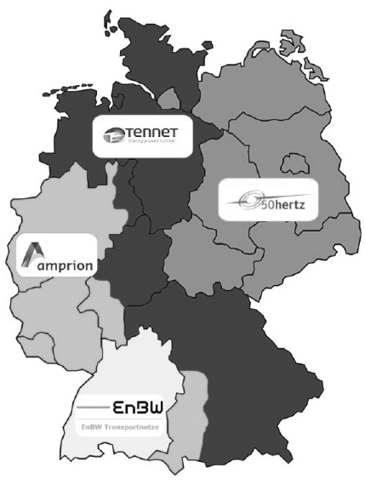
Reserve market
V2G can contribute to system cost reductions (Kempton & Tomic, 2005)
Literature suggests system services in reserve markets as business case for fleet operators (Sioshansi et al. 2011)
With 1 million EV in 2020:
Up to 3.6 GW capacity for reserve markets with home charging outlets and 100% availability
hour |  | 0-4 | 4-8 | 8-12 | 12-16 | 16-20 | 20-24
neg. | power | 17 | 17 | 3 | 3 | 3 | 4 |  | €/MW
neg. | energy | 39 | 42 | 20 | 18 | 18 | 21 |  | €/MWh
pos. | power | 1 | 1 | 5 | 3 | 3 | 1 |  | €/MW
pos. | energy | 333 | 353 | 363 | 411 | 415 | 378 |  | €/MWh
Average prices tertiary reserve market (Source: Mischinger et al., 2011)

Slide 13
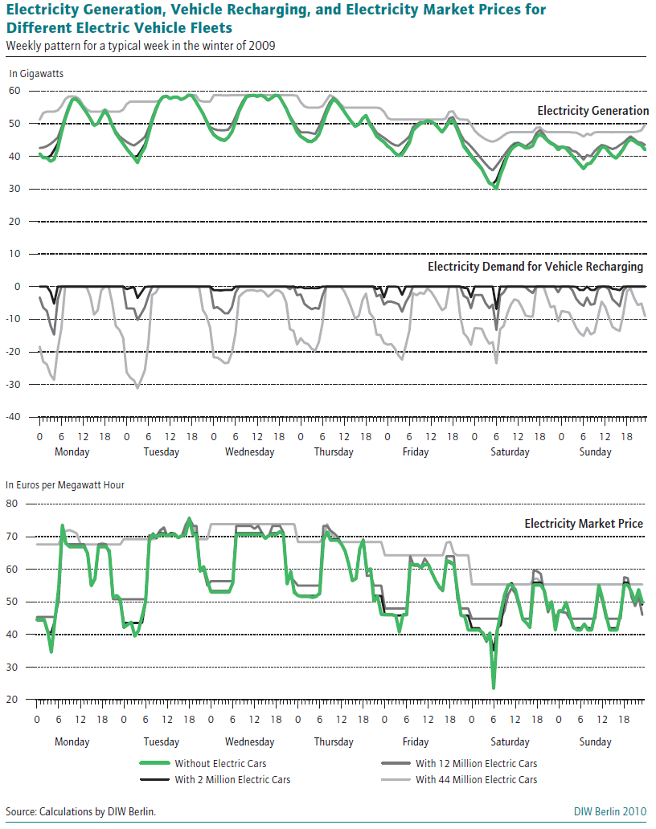
Potential results
Effects on dispatch
Effects on CO2 emissions
Price and system cost effects
Analysis of business case for reserve energy provision of V2G-capable EV

Slide 14
Division of work
In Work packages 2 and 7, two electricity market models are developped. The TU Vienna model focuses on power grids, the DIW model focuses on unit commitment, storage and reserve markets.
 | DIW Berlin | TU Vienna
Model Type | Mixed Integer LP | Linear Program
Geographic coverage | DE+neighbours | AT
Storage | Yes | Yes
Grid | Only interconnectors. | All 380/220 kV lines ?
Results | CO2 emissions, prices, cost | Grid stability ?
Use of results in Work package 9 „Quantification of Environmental Benefits“

Slide 15
Timeline
Long time for elaboration of models until mid 2014
Final report end of 2014 but interim reports every 6 months
No workshop explicitely on electricity market models
 | 2012 |  |  |  |  |  |  | 2013 |  |  |  |  |  |  |  |  |  |  |  | 2014
 | 6 | 7 | 8 | 9 | 10 | 11 | 12 | 1 | 2 | 3 | 4 | 5 | 6 | 7 | 8 | 9 | 10 | 11 | 12 | 1 | 2 | 3 | 4 | 5 | 6 | 7 | 8 | 9 | 10 | 11
Kick-off workshop | x
Workshop Scenarios |  |  |  |  |  |  |  |  | x
Completed model |  |  |  |  |  |  |  |  |  |  |  |  |  |  |  |  |  |  |  |  |  |  | X
Completed results |  |  |  |  |  |  |  |  |  |  |  |  |  |  |  |  |  |  |  |  |  |  |  |  |  | X
Dissemination |  |  |  |  |  |  |  |  |  |  |  |  |  |  |  |  |  |  |  |  |  |  |  |  |  |  |  |  |  | X
Final Conference |  |  |  |  |  |  |  |  |  |  |  |  |  |  |  |  |  |  |  |  |  |  |  |  |  |  |  |  |  | X
Interim reports |  |  |  |  |  |  | x |  |  |  |  |  | x |  |  |  |  |  | x |  |  |  |  |  | x

Slide 17
Model (Back-up)
Model features
Block-sharp power plant data
Part load inefficiencies
Start-up constraints
Ramping cost
Ramping limits
Storage constraints
DSM constraints and cost
Decommissioning of existing power plants in Germany (Source: Own production)

Slide 18
Available data
 | Source
Wholesale prices | Historic EEX data for Austria and Germany; no data for Poland
Demand | ENTSO-E for all UCTE countries
Installed capacities | Platts (October 2011) Database covering whole Europe
Grid | TU Berlin – ELMOD Database for all lines 380kV/220kV in UCTE region
Renewables | Open Access database of ECMWF
Reserve market | Historic prices for Germany on regelenergie.net

